Slide 1

Subject Name: OOP
Unit No:1
Unit Name: Introduction to OOP

Slide 2
Index
Lecture 4 – Features of Java Language, JDK environment | 3
Lecture 5 – Basic Constructs of Java Programming | 13
Lecture 6 – Input and output functions in Java : Buffered reader class, Scanner class | 39

Slide 3
Module No 1: Introduction to OOP
Lecture No: 4
Features of Java Language, JDK environment

Slide 4


Introduction to JAVA
A general purpose object oriented programming language developed by Sun Microsystems in 1991.
Originally called Oak by James Gosling, the first designer of Java and implemented its original compiler and virtual machine.
Renamed as JAVA in 1995
Versions
  Java 2 Micro Edition (J2ME)
  Java 2 Standard Edition (J2SE)
  Java 2 Enterprise Edition (J2EE)
Lecture 4- Features of Java Language, JDK environment

Slide 5
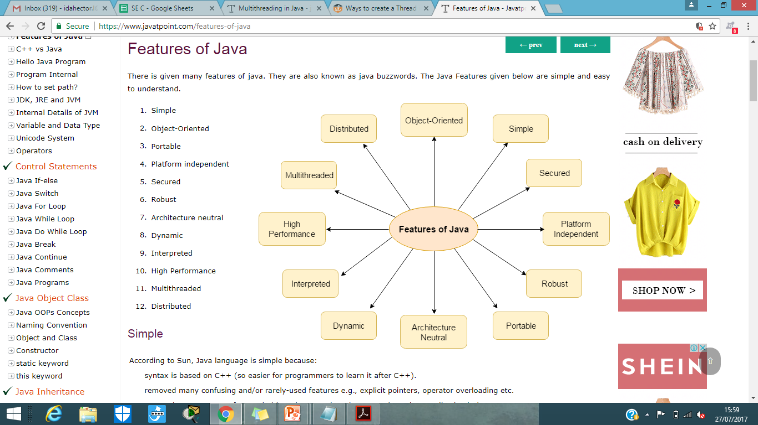
Features of Java
Lecture 4- Features of Java Language, JDK environment

Slide 6
Features of Java
Simple:
Easy to learn.
removed many confusing and rarely-used features
e.g., explicit pointers, operator overloading etc.
Object-oriented:
Organize our software as a combination of different types of objects that incorporates both data and behaviour.
Lecture 4- Features of Java Language, JDK environment

Slide 7
Features of Java
Platform Independent:
A platform is the hardware or software environment in which a program runs.
It has two components:
  Runtime Environment
  API(Application Programming Interface)
“Write-Once Run-Anywhere”
Java code can be run on multiple platforms e.g. Windows, Linux, Sun Solaris, Mac/OS etc.
Lecture 4- Features of Java Language, JDK environment

Slide 8
Features of Java
Robust:
Strong memory management.
No usage of pointers.
Exception handling and type checking mechanisms.
  “An Exception is the condition that is caused by run time error in the program. If it occurred java interpreter creates an exception object and throws it.”
Lecture 4- Features of Java Language, JDK environment

Slide 9
Features of Java
Multi-threaded
A thread is like a separate program, executing concurrently.
Java programs deal with many tasks at once by defining multiple threads.
Doesn't occupy memory for each thread.
Shares a common memory area.
Lecture 4- Features of Java Language, JDK environment

Slide 10
Features of Java
Distributed and Network Oriented
Java grew up in the days of the Internet
  Inherently network friendly
  Original release of Java came with Networking libraries
  Newer releases contain even more for handling distributed applications
    - RMI, Transactions
Lecture 4- Features of Java Language, JDK environment

Slide 11
Features of Java
Compiled and Interpreted
Java works in two stage
  Java compiler translate the source code into byte code.
  Java interpreter converts the byte code into machine level representation.
Byte Code:
  - A highly optimized set of instructions to be executed by the java runtime system, known as java virtual machine (JVM).
  - Not executable code.
Java Virtual Machine (JVM):
  Need to be implemented for each platform.
  Although the details vary from machine to machine, all JVM understand the same byte code.
Lecture 4- Features of Java Language, JDK environment

Slide 12
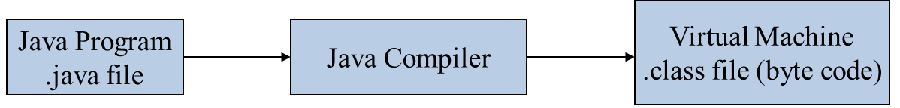
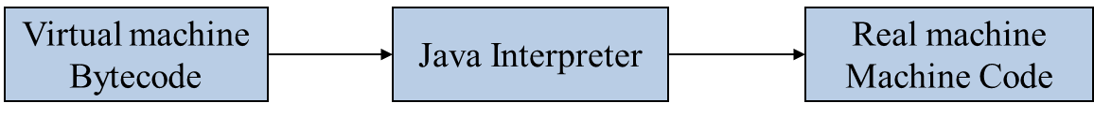
Java Virtual Machine
Java compiler produces an intermediate code known as byte code for a machine, known as JVM.
It exists only inside the computer memory.
Machine code is generated by the java interpreter by acting as an intermediary between the virtual machine and real machine.
Lecture 4- Features of Java Language, JDK environment

Slide 13
Module No 1: Introduction to OOP
Lecture No: 5
Basic Constructs of Java Programming

Slide 14

Simple Java Program
// Program to print Hello message
public class Hello
{
}
public static void main (String[ ] args)
{
}
System.out.print (“Hello”);
Lecture 5- Basic Constructs of Java Programming

Slide 15
Java Program Structure
// comments about the class
public class MyProgram
{
}
class header
// comments about the method
public static void main (String[ ] args)
{
}
class body
method header
method body
Lecture 5- Basic Constructs of Java Programming

Slide 16
Compile and Execute Java Program
Type it in with the text editor of your choice
Java program
filename.java
javac
Java compiler
Java byte code
filename.class
)
To compile the program at the command line type "javac filename.java"
Java Interpreter
java
To run the interpreter, at the command line type "java filename"
Lecture 5- Basic Constructs of Java Programming

Slide 17
Basic Constructs of Java
Constants
Variables
Data Types
Operators and Expression
Revision of Branching and Looping
Lecture 5- Basic Constructs of Java Programming

Slide 18
Constants
  The variable whose value is always constant (does not change).
  The reserved word final is used in constant declaration.
  Syntax:
  final data_type constant_name=constant_value;
Lecture 5- Basic Constructs of Java Programming

Slide 19
Variables
  A variable can be thought of as a container which holds value for you, during the life of a Java program.
  Every variable is assigned a data type which designates the type and quantity of value it can hold.
  All variables must be declared before its use.
  Variables can be declared almost anywhere (scope rules apply)
  Variables have default initialization values
      Integers: 0
      Reals: 0.0
      Boolean: False
  Variables can be initialized in the declaration.
  Syntax:
[access_modifier] [static] [final] type name = [value];
Lecture 5- Basic Constructs of Java Programming

Slide 20
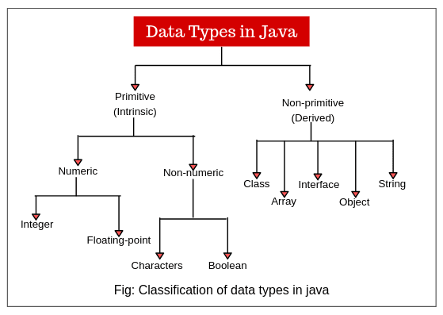
Data Types
Lecture 5- Basic Constructs of Java Programming

Slide 21
Data Types
Primitive Data Types
  byte (1), -128 to 127
  short (2), -32768 to 32767
  int (4), -2147483648 to 2147483647
  long (8), -9223372036854775808 to 9223372036854775807
  float (4), -3.4E38 to 3.4E38, 7 digit precision
  double (8), -1.7E308 to 1.7E308, 17 digits precision
  char (2), unicode characters
  boolean (true, false), discrete values
Non-primitive/ User-defined Data Types
  Array
  Class
  interface
Lecture 5- Basic Constructs of Java Programming

Slide 22
Keywords in Java
These are the reserved words in JAVA which cannot be used as variable names or identifiers.
abstract | continue | for | new | switch
assert*** | default | goto* | package | synchronized
boolean | do | if | private | this
break | double | implements | protected | throw
byte | else | import | public | throws
case | enum**** | instanceof | return | transient
catch | extends | int | short | try
char | final | interface | static | void
class | finally | long | strictfp** | volatile
const* | float | native | super | while
Lecture 5- Basic Constructs of Java Programming

Slide 23

Java Operators
Operators/Order of Precedence
Operator | Operation | Precedence
() or [ ] or . or ++ or - - | Parens, array indices, object invocation, increment, decrement | 1
+ or – or ~ | Unary plus, unary minus, complement | 2
* or / or % | Multiplication, division, modulus | 3
+ or - | Addition, subtraction | 4
<<,>> | Bitwise shifts | 5
& | Bitwise AND | 6
^ | Bitwise XOR | 7
| | Bitwise OR | 8
Lecture 5- Basic Constructs of Java Programming

Slide 24

Java Operators
Example Usage
  int anInt1 = 2, anInt2 = 1, anInt3;
  double aDbl1;
  anInt3 = anInt1 + anInt2 * 4; // anInt3 gets 6
  anInt3 = (anInt1 + anInt2) * 4; // anInt3 gets 12
  anInt3 = ++anInt2 * 2; // anInt3 gets 4
  anInt2 = 1;
  anInt3 = anInt2++ * 2; // anInt3 gets 2
  anInt2 = 1;
  anInt3 = anInt1 & anInt2; // anInt3 gets 0
  anInt3 = anInt1 ^ anInt2; // anInt3 gets 3
  anInt3 = anInt2 << 1; // anInt3 gets 2
  anInt3 = 1 / 2; // anInt3 gets 0
  aDbl1 = 1 / 2; // aDbl1 gets 0.0
  aDbl1 = 1.0 / 2.0; // aDbl1 gets 0.5
Lecture 5- Basic Constructs of Java Programming

Slide 25
Java Operators…..
Assignments
  General Format: variable = expression ;
    Where variable is a previously declared identifier and
    expression is a valid combo of identifiers, operators,
    and method (a.k.a. procedure or function) calls
  Shortcuts:
  var *= expr ; // Equivalent to var = var * (expr);
  var /= expr ; // Equivalent to var = var / (expr);
  var += expr ; // Equivalent to var = var + (expr);
  var -= expr ; // Equivalent to var = var – (expr);
  var %= expr ; // Equivalent to var = var % (expr);
  var++; // Equivalent to var = var + 1;
  var--; // Equivalent to var = var - 1;
Lecture 5- Basic Constructs of Java Programming

Slide 26
Control Statements in Java
1. Conditional Statements
if-else statements
switch case statements
2. Iterative Statements
for loop
while loop
do-while loop
Lecture 5- Basic Constructs of Java Programming

Slide 27
Java Conditional Constructs
“if” Statements
  if with code block
  if (boolean_expr)
  {
  statements
  }
  if with single statement
  if (boolean_expr)
  statement;
Lecture 5- Basic Constructs of Java Programming

Slide 28
Java Conditional Constructs
if” Statements (Continued)
  if-else
  if (boolean_expr)
  {
  statements for true
  }
  else
  {
  statements for false
  }
if
true
false
statements
statements
Lecture 5- Basic Constructs of Java Programming

Slide 29
Java Conditional Constructs
Boolean Expressions
  Boolean expressions use conditional operators such that they result in a value of true or false
  Conditional Operators (Not by order of precedence)
Operators | Operations
== or != | Equality, not equal
> or < | Greater than, less than
>= or <= | Greater than or equal, less than or equal
! | Unary negation (NOT)
& or && | Evaluation AND, short circuit AND
| or || | Evaluation OR, short circuit OR
Lecture 5- Basic Constructs of Java Programming

Slide 30

Java Conditional Constructs
Boolean Expression Examples
  int i1 = 1, i2 = 2, i3 = 3, i4 = 0;
  boolean b1 = true, b2 = false, b3 = true;
  i2 > i1 // true
  (i3 – i2) > i1 // false
  (i3 – i2) >= i1 // true
  (i2 > i1) & (i2 < i3) // true
  (i2 < i1) | (i2 > i1) // true
  i2 != i1 // true
  (i1 < i2) | ((i1/i4) > 1) // Divide by 0 exception
  (i1 < i2) || ((i1/i4) > 1) // true
  (i1 < i2) | (i1++ > 1) // true, i1 contains 2
  (i1 < i2) || (i1++ > 1) // true, i1 contains 1
  b1 && b2 && b3 // false
  (b1 || b2) && b3 // true
  b1 && (i1 == (i3 – i2)) // true
Lecture 5- Basic Constructs of Java Programming

Slide 31
Java Conditional Constructs
if-else” Statement Example
class Example
{
static public void main(String args[])
{
// A very contrived example
int i1 = 1, i2 = 2;
System.out.print(“Result: “);
if (i1 > i2)
{
System.out.println(“i1 > i2”);
}
else
{
System.out.println(“i2 >= i1”);
}
}
}
if
true
false
statements
statements
Lecture 5- Basic Constructs of Java Programming

Slide 32
Java Conditional Constructs
The Switch Statement
  switch (integer_expression)
  {
  case int_value_1:
  statements
  break;
  case int_value_2:
  statements
  break;
  …
  case int_value_n:
  statements
  break;
  default:
  statements
  }
if
true
statements
false
if
true
statements
false
if
true
statements
false
statements
Lecture 5- Basic Constructs of Java Programming

Slide 33
Java Conditional Constructs
Don’t forget the “break”
  switch (integer_expression)
  {
  case int_value_1:
  statements
  // No break!
  case int_value_2:
  statements
  break;
  …
  case int_value_n:
  statements
  break;
  default:
  statements
  }
if
true
statements
false
if
true
statements
false
if
true
statements
false
statements
Lecture 5- Basic Constructs of Java Programming

Slide 34
Java Conditional Constructs
Example
  int n = 5;
  switch (n)
  {
  case 1:
  n = n + 1;
  break;
  case 5:
  n = n + 2;
  break;
  default:
  n = n – 1;
  }
if
true
statements
false
if
true
statements
false
statements
Lecture 5- Basic Constructs of Java Programming

Slide 35
Java Looping Constructs
while loop
  Exit condition evaluated at top
do loop
  Exit condition evaluated at bottom
for loop
  Exit condition evaluated at top
  Includes a initialization statements
  Includes a update statements for each iteration
Lecture 5- Basic Constructs of Java Programming

Slide 36
Java Looping Constructs
while loop
  while (boolean_expr)
  {
  statements
  }
do loop
  do
  {
  statements
  }
  while (boolean_expr)
false
if
true
statements
statements
if
true
false
Lecture 5- Basic Constructs of Java Programming

Slide 37
Java Looping Constructs
for loop
  for (init_stmnt; bool_expr; update_stmnt)
  {
  statements
  }
init
false
if
true
statements
update
Lecture 5- Basic Constructs of Java Programming

Slide 38
Java Looping Constructs
class Example
{ static public void main(String args[])
{
int i = 0;
System.out.println("while loop");
while (i < 10)
{
System.out.println(i);
i++;
}
System.out.println("do loop");
do
{
System.out.println(i);
i--;
}
while (i > 0);
System.out.println("for loop");
for (i = 0; i < 10; i++)
{
System.out.println(i);
}
} // End main
} // End Example
Lecture 5- Basic Constructs of Java Programming

Slide 39
Module No 1: Introduction to OOP
Lecture No: 6
Input and output functions in Java : Buffered reader class, Scanner class

Slide 40
Input/Output
Java I/O (Input and Output) is used to process the input and produce the output.
Java uses the concept of a stream to make I/O operation fast.
The java.io package contains all the classes required for input and output operations.
We can perform file handling in Java by Java I/O API.
Lecture 6- Input and output functions in Java : Buffered reader class, Scanner class

Slide 41
Input/Output
Stream - A stream is a sequence of data. In Java, a stream is composed of bytes. It's called a stream because it is like a stream of water that continues to flow.
In Java, 3 streams are created for us automatically. All these streams are attached with the console.
  System.out: standard output stream
  System.in: standard input stream
  System.err: standard error stream
Lecture 6- Input and output functions in Java : Buffered reader class, Scanner class

Slide 42
OutputStream vs InputStream
OutputStream - Java application uses an output stream to write data to a destination; it may be a file, an array, peripheral device or socket.
InputStream - Java application uses an input stream to read data from a source; it may be a file, an array, peripheral device or socket.
Lecture 6- Input and output functions in Java : Buffered reader class, Scanner class

Slide 43
OutputStream class
OutputStream class is an abstract class. It is the superclass of all classes representing an output stream of bytes. An output stream accepts output bytes and sends them to some sink.
Useful methods of OutputStream
Method | Description
1) public void write(int)throws IOException | is used to write a byte to the current output stream.
2) public void write(byte[])throws IOException | is used to write an array of byte to the current output stream.
3) public void flush()throws IOException | flushes the current output stream.
4) public void close()throws IOException | is used to close the current output stream.
Lecture 6- Input and output functions in Java : Buffered reader class, Scanner class

Slide 44
OutputStream class
OutputStream Hierarchy
Lecture 6- Input and output functions in Java : Buffered reader class, Scanner class

Slide 45
InputStream class
InputStream class is an abstract class. It is the superclass of all classes representing an input stream of bytes.
Useful methods of OutputStream
Method | Description
1) public abstract int read()throws IOException | reads the next byte of data from the input stream. It returns -1 at the end of the file.
2) public int available()throws IOException | returns an estimate of the number of bytes that can be read from the current input stream.
3) public void close()throws IOException | is used to close the current input stream.
Lecture 6- Input and output functions in Java : Buffered reader class, Scanner class

Slide 46
InputStream class
InputStream Hierarchy
Lecture 6- Input and output functions in Java : Buffered reader class, Scanner class

Slide 47
Classes used for Reading Information
BufferedReader (has always been there)
  import java.io.*;
Scanner (specific to JAVA 5 and beyond)
  import java.util.*;
Lecture 6- Input and output functions in Java : Buffered reader class, Scanner class

Slide 48
java.io.BufferedReader
The BufferedReader class can only read Strings
However we can transform those Strings into numbers of any kind.
This one is always safe.
Lecture 6- Input and output functions in Java : Buffered reader class, Scanner class

Slide 49
Two Objects and one Exception
In the class:
  public static void main(String args[ ]) throws IOException{
InputStreamReader isr = new InputStreamReader(System.in);
BufferedReader br = new BufferedReader(isr);
The method:
    String readLine( )
Lecture 6- Input and output functions in Java : Buffered reader class, Scanner class

Slide 50
Reading a String with BufferedReader
Reading a String
InputStreamReader isr = new InputStreamReader (System.in);
BufferedReader br = new BufferedReader(isr);
String sName;
System.out.print(“What is your name? “);
sName = br.readLine( );
System.out.println(“So your name is “ + sName);
Lecture 6- Input and output functions in Java : Buffered reader class, Scanner class

Slide 51
Reading integers with BufferedReader
Reading an int number
String sPlaceHolder;
int iAge =0;
int iYear = 2023;
System.out.print(“How old are you? “);
sPlaceHolder = br.readLine( );
iAge = Integer.parseInt(sPlaceHolder);
System.out.println(“So you are “ + iAge + “ years old”);
System.out.println(“you were probably born in “+ (iYear - iAge));
Lecture 6- Input and output functions in Java : Buffered reader class, Scanner class

Slide 52
Reading doubles with BufferedReader
    Reading a double number
    final double dGoal = 1000000; //constant
    double dEarnings = 0;
    double dMissing = 0;
    System.out.print(“How much do you make per hour? “);
    sPlaceHolder = br.readLine( )
    dEarnings = Double.parseDouble(sPlaceHolder);
    dMissing = dGoal - dEarnings;
    System.out.println(“\nIn one hours you will only need “ + iMissing + “more to earn your goal”);
Lecture 6- Input and output functions in Java : Buffered reader class, Scanner class

Slide 53
Scanner syntax
    The Scanner class is found in the java.util package.
    import java.util.*; // so you can use Scanner
    Constructing a Scanner object to read console input:
    Scanner name = new Scanner(System.in);
    Example:
    Scanner sc = new Scanner(System.in);
Lecture 6- Input and output functions in Java : Buffered reader class, Scanner class

Slide 54
Scanner Class -The Methods
    Constructor
    Scanner sc = new Scanner(System.in);
    Reading a String
    String sc.nextLine( );
    Reading an int
    int sc.nextInt( );
    Reading a double
    double sc.nextDouble( );
Lecture 6- Input and output functions in Java : Buffered reader class, Scanner class

Slide 55
Scanner methods
    Each method waits until the user presses Enter.
    The value typed by the user is returned.
    Example: System.out.print("How old are you? "); // prompt
    int age = sc.nextInt();
    System.out.println("You typed " + age);
Method | Description
nextInt() | reads an integer from the user
nextDouble() | reads a double from the user
next() | reads a one-word String from the user
nextLine() | reads a one-line String from the user
Lecture 6- Input and output functions in Java : Buffered reader class, Scanner class

Slide 56
Reading a String with the Scanner class
Reading a String
Scanner scan = new Scanner(System.in);
String str;
System.out.print(“What is your name? “);
str = scan.nextLine( );
System.out.println(“So your name is “ + str);
Lecture 6- Input and output functions in Java : Buffered reader class, Scanner class

Slide 57
Reading integers with the Scanner class
Reading an int number
    Scanner scan = new Scanner(System.in);
    int iAge = 0;
    Int iYear = 2023;
    System.out.print(“How old are you? “);
    iAge = scan.nextInt( );
    iYear = iYear - iAge;
    System.out.println(“\nSo you were born around “ + iYear);
Lecture 6- Input and output functions in Java : Buffered reader class, Scanner class

Slide 58
Reading doubles with the Scanner Class
Reading a double number
    Scanner scan = new Scanner(System.in);
    final double dGoal = 1000000; //constant
    double dEarnings = 0;
    double dMissing = 0;
    System.out.print(“How much do you make per hour? “);
    dEarnings = scan.nextDouble( );
    dMissing = dGoal - dEarnings;
    System.out.println(“\nIn one hours you will only need “ + iMissing + “more to earn your goal”);
Lecture 6- Input and output functions in Java : Buffered reader class, Scanner class

Slide 59
Difference between Scanner and BufferReader Class in Java
Sr. No. | Key | Scanner Class | BufferReader Class
1 | Synchronous | Scanner is not synchronous in nature and should be used only in single threaded case. | BufferReader is synchronous in nature. During multithreading environment, BufferReader should be used.
2 | Buffer Memory | Scanner has little buffer of 1 KB char buffer. | BufferReader has large buffer of 8KB byte Buffer as compared to Scanner.
3 | Processing Speed | Scanner is bit slower as it need to parse data as well. | BufferReader is faster than Scanner as it only reads a character stream.
4 | Methods | Scanner has methods like nextInt(), nextShort() etc. | BufferReader has methods like parseInt(), parseShort() etc.
5 | Read Line | Scanner has method nextLine() to read a line. | BufferReader has method readLine() to read a line.
Lecture 6- Input and output functions in Java : Buffered reader class, Scanner class

Slide 60
Thank You

